Slide 1

Microsoft Workshop: Hands-On Lab About Telemetry
Christian Heide Damm
Joost Bulsink
Kennie Nybo Pontoppidan
Purusharth Dwivedi
Jens Møller-Pedersen
and special friends…

Slide 2
Agenda
Want to get started with telemetry and the many capabilities it unlocks? Do you find it hard to get started? Then come to this workshop and get unblocked. Bring a laptop and have telemetry enabled on ono or more environments or apps prior to the workshop. If you also have a Power BI pro license, you can get really far. In the workshop, telemetry experts from Microsoft and the community will be available to help you get unblocked with whatever you find difficult.

Slide 3
Telemetry Maturity model

Slide 4
Maturity model
Pervasive
Strategic
Focused
Tactical
Unaware
Have just enabled
telemetry
Select roles
use telemetry
Projects include
telemetry
Cross-customer (or cross-app) use
Pervasive
Telemetry enables
proactiveness

Slide 5
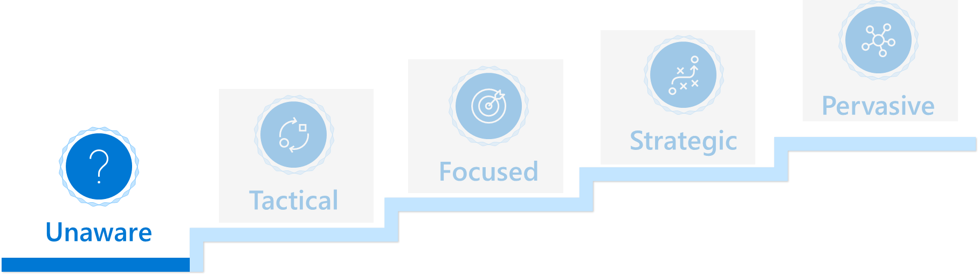
Unaware
Characteristics
Advice
Telemetry is enabled on one or more environments or apps
Partner knows this is important but does not know how to proceed
Help partner get some quick wins
Show insights from the Usage reporting from the Application Insights portal to the business sponsor
Show insights from the performance Power BI report to the technical sponsor

Slide 6
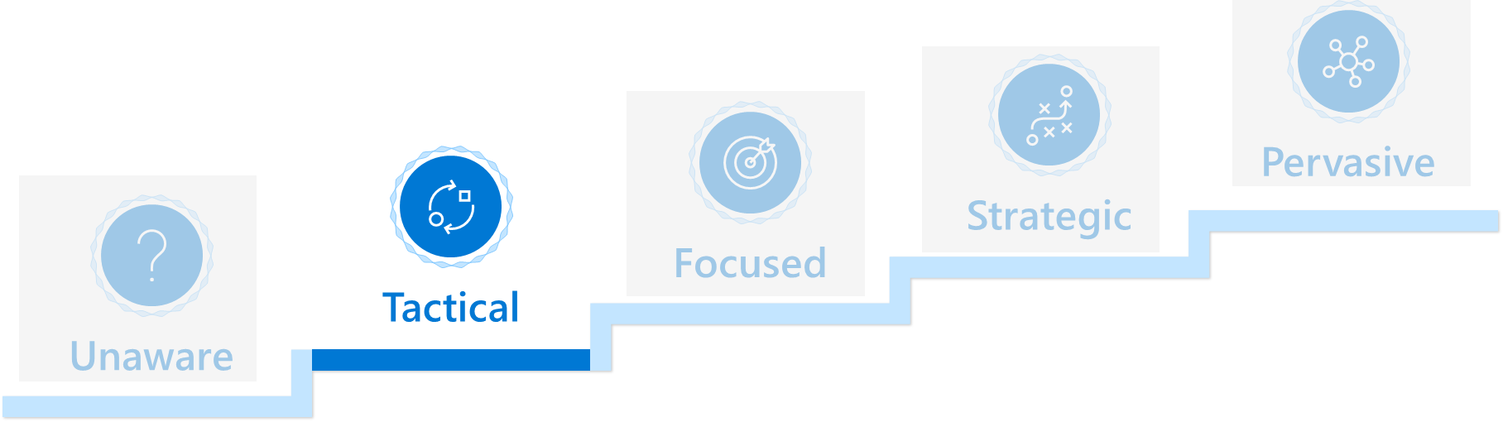
Tactical
Characteristics
Advice
One or more role (typically troubleshooter/support) within the partner org use telemetry
Other roles within partner can see that this benefits roles that use telemetry, but telemetry feels like it is only for the techies
Enhance partners knowledge
Business sponsor must know about
Usage reporting from the Application Insights portal
Extension lifecycle signal
Telemetry about reports and pages that customers use
Technical sponsor must know about
The performance Power BI report
The error Power BI report
Jupyter notebook TSGs
KQL samples

Slide 7
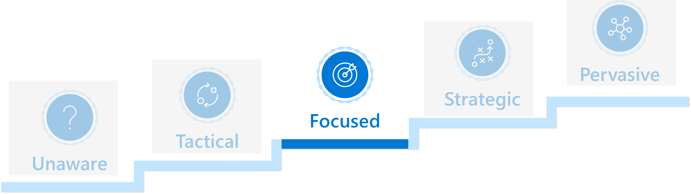
Focused
Characteristics
Advice
Telemetry (and analytics) is being used during implementation projects
Make telemetry investments repeatable and cross-customer
Business sponsor must know about
Funnel reporting from the Application Insights portal (how are users using the product)
Extension lifecycle signal (lifecycle reporting across customers)
Technical sponsor must know about
How to do custom telemetry in extensions
Query telemetry using KQL
How to make your own Power BI reports on telemetry data
How to export telemetry data to a data lake

Slide 8
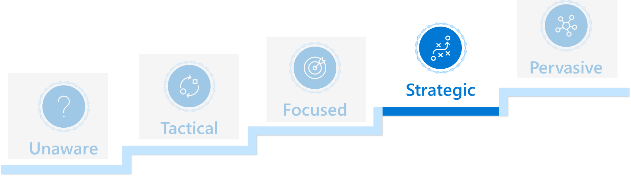
Strategic
Characteristics
Advice
Partner have cross-customer (or cross-app) dashboards that track metrics such as upgrade failure rates, performance regressions, app failure rates
Get from reactive to proactive
Move strategic reporting to use a data lake instead of direct KQL queries
Talk about the difference between tactical and strategic use of telemetry
Learn about alerts and alert channels

Slide 9
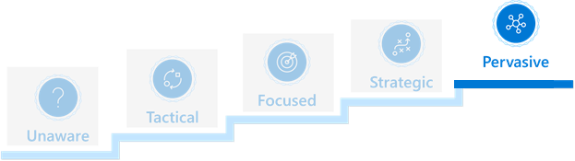
Pervasive
Characteristics
Advice
Partner use telemetry to support most processes
Use the full palette of telemetry tools in all processes
Learn about alerts and alert channels
Share telemetry insights with customers
Challenge if partner use telemetry data for
Sales
Implementation
Maintenance
Follow-ups and post-sales
Feedback loop from telemetry data into partner processes (improve existing processes)

Slide 10
Possible things you might want to do today

Slide 11
Possible things to do today
Initial look at telemetry through the Power BI app(s)
get help with insights
Getting cost under control
look at cost data and telemetry usage and see my options
Get started with alerting
set up Logic app from docs samples and look at the alerting scenarios
Learning KQL on real data

Slide 12
Resources (Power BI apps)
App install links
https://aka.ms/bctelemetryreport
https://aka.ms/bctelemetry-isv-app
Documentation (setup, configuration, and usage)
https://learn.microsoft.com/en-us/dynamics365/business-central/dev-itpro/administration/telemetry-power-bi-app

Slide 13
Resources (Cost)
These are the cost control measures that we have documented
https://learn.microsoft.com/en-us/dynamics365/business-central/dev-itpro/administration/telemetry-overview#ingest
https://github.com/microsoft/BCTech/blob/master/samples/AppInsights/FAQ.md#what-does-it-cost (data collection rules)

Slide 14
Resources (Alerting)
Alerting guidance and samples available
https://learn.microsoft.com/en-us/dynamics365/business-central/dev-itpro/administration/telemetry-overview#setting-up-alerts-on-telemetry-events
https://github.com/microsoft/BCTech/tree/master/samples/AppInsights/Alerts (sample scenarios and KQL for alerting)

Slide 15
Resources (Learning KQL)
https://github.com/microsoft/BCTech/blob/master/samples/AppInsights/VIDEOS.md#how-can-i-write-custom-kusto-queries-in-dynamics-365-business-central-9-min (walkthrough: your first query)
https://github.com/microsoft/BCTech/tree/master/samples/AppInsights/KQL#where-can-i-learn-more-about-kql (learning resources)

Slide 16
Resources (Docs and FAQ)
Telemetry FAQ
https://github.com/microsoft/BCTech/blob/master/samples/AppInsights/FAQ.md
Docs overview
https://learn.microsoft.com/en-us/dynamics365/business-central/dev-itpro/administration/telemetry-overview

Slide 17
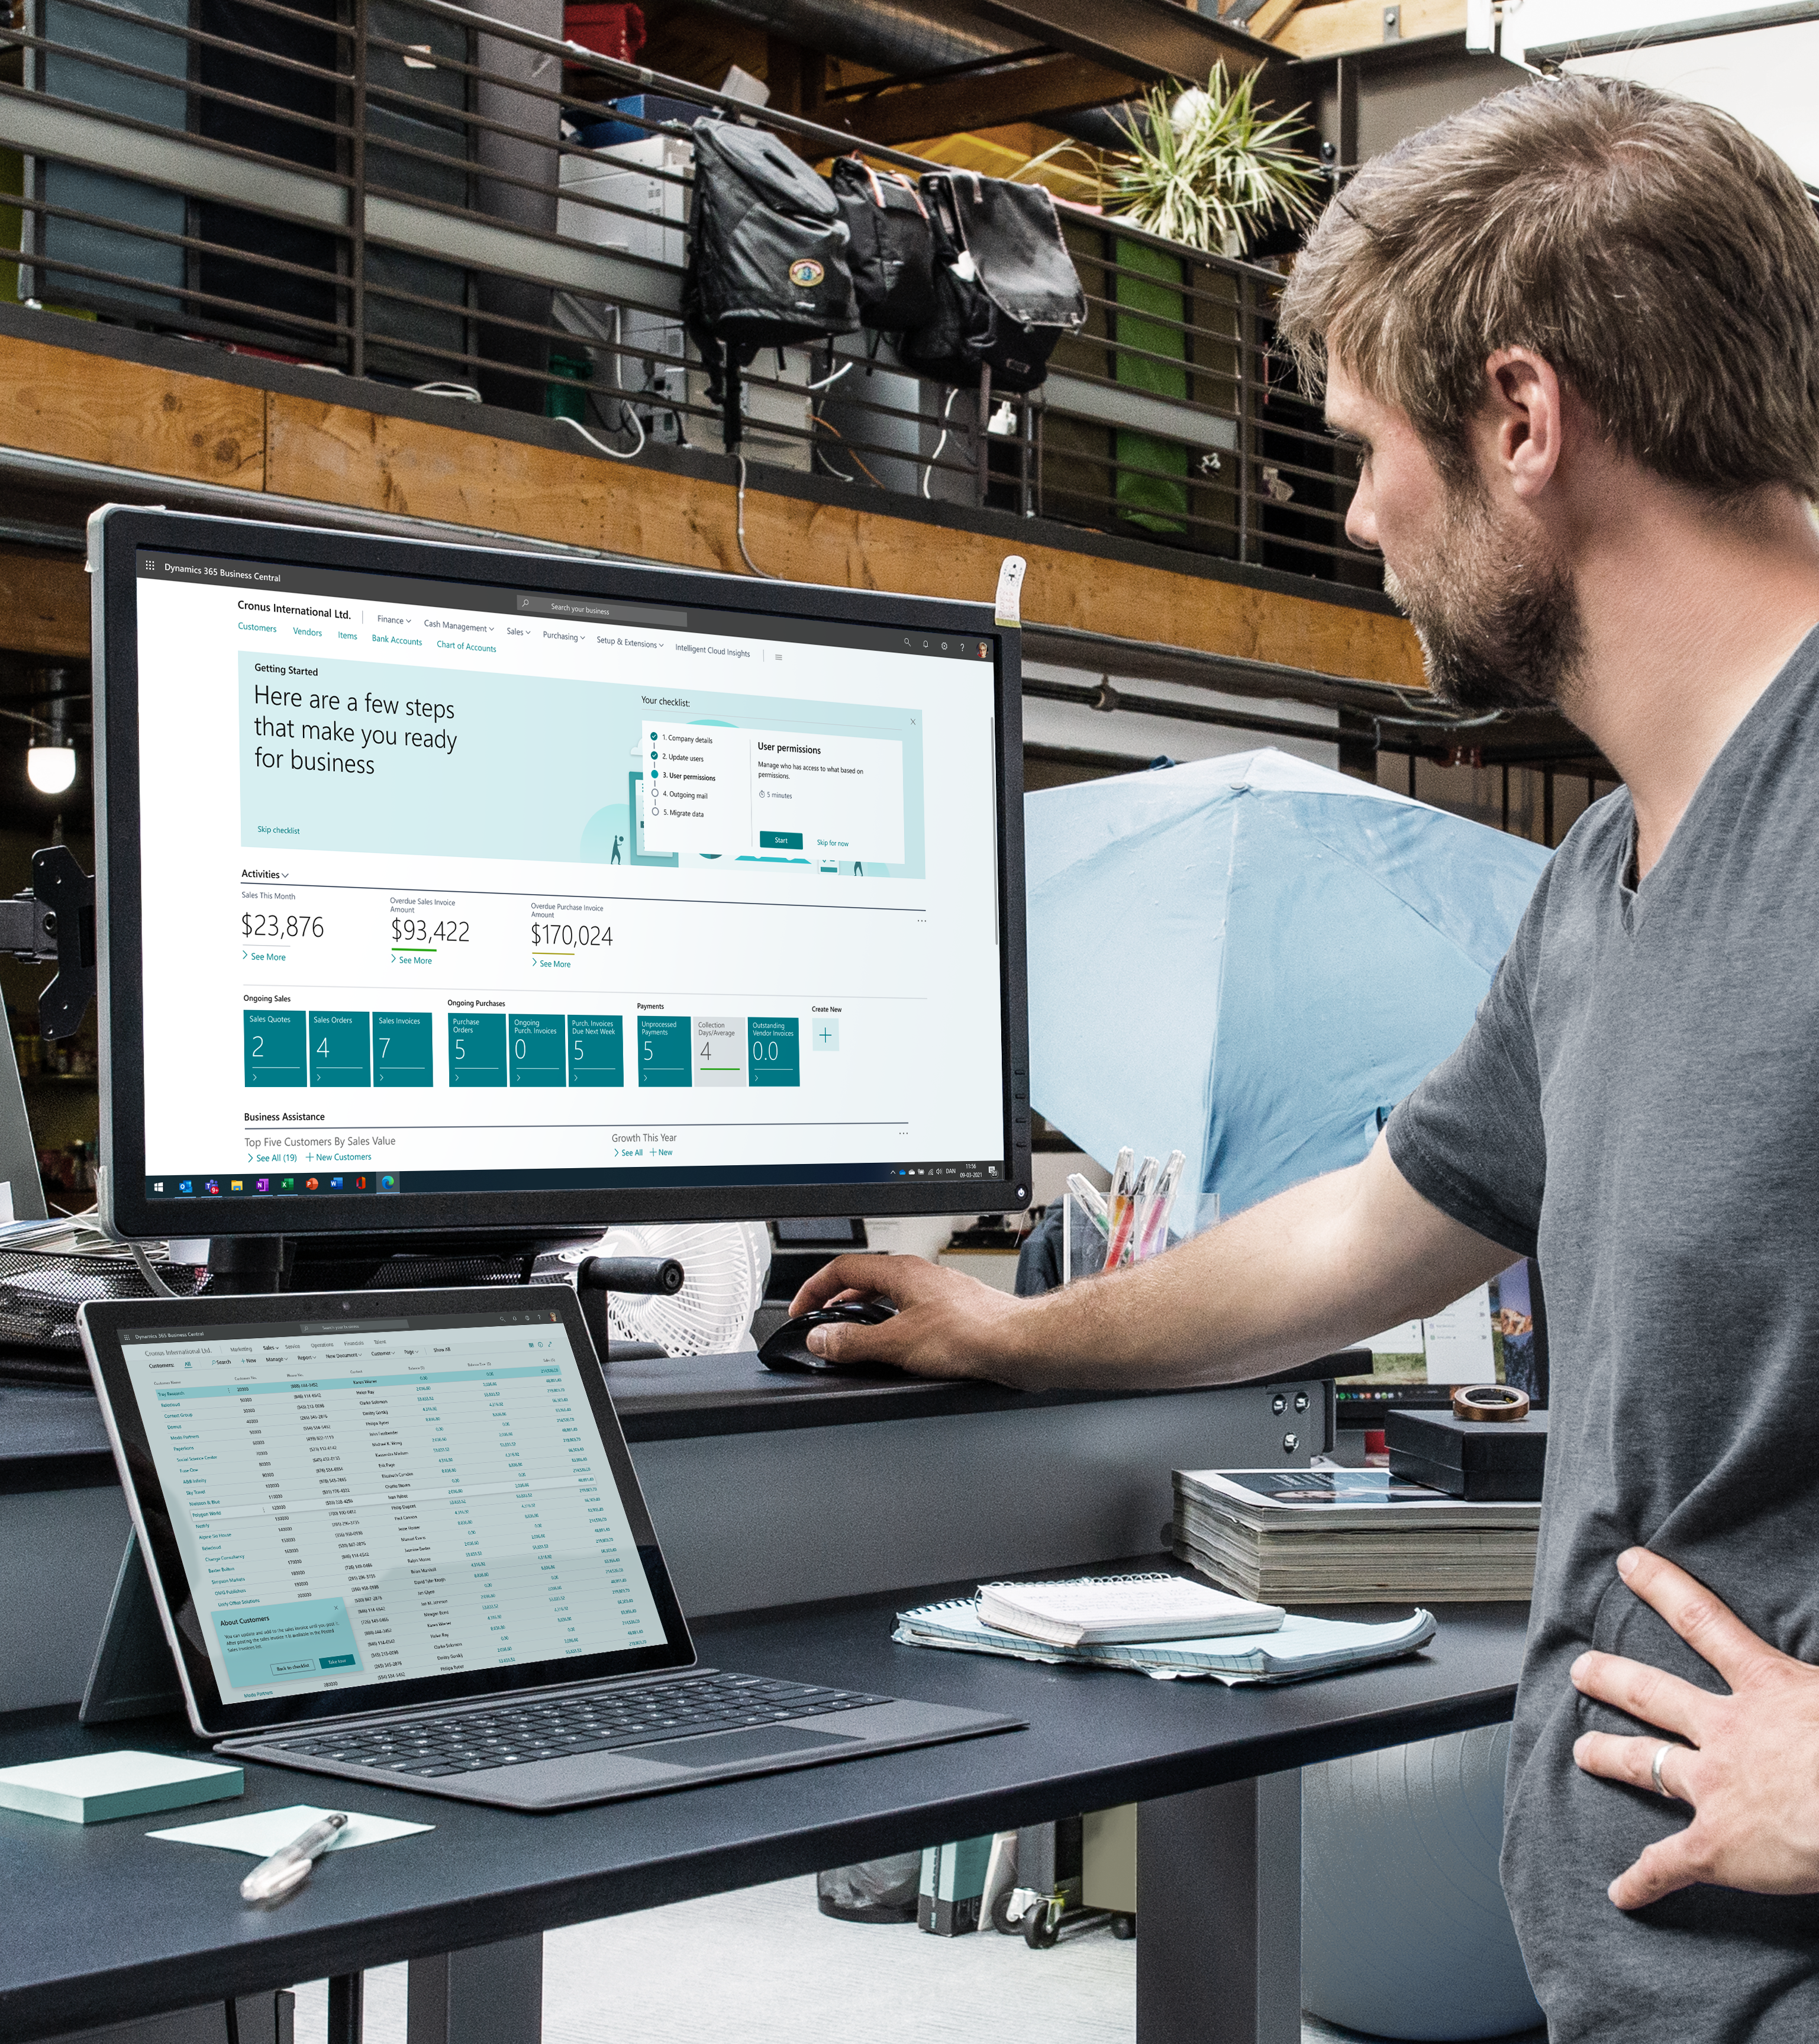



Other resources
Learn more!
Have a question? aka.ms/BCYammer
Join the conversation https://twitter.com/MSDYN365BC
Looking for resources? aka.ms/BCAll
Submit your ideas aka.ms/BCIdeas
Didn’t watch the launch event? aka.ms/BCLE

Slide 18
Thank you

